Slide 1

Lecture 15 Query Processing
(Chapter 15)
Prof. Jihong Guan
Email: jhguan@tongji.edu.cn
Department of Computer Science and Technology
Tongji University

Slide 2
Outline of the Course
Part 0: Overview
Ch1: Introduction
Part 1 Relational Databases
Ch2: Relational model (data model, relational algebra)
Ch3&4: SQL(Structured Query Language)
Ch5: Advanced SQL
Part 2 Database Design
Ch6: Database design based on E-R model
Ch7: Relational database design
Part 3 Application Design & Development
Ch8: Complex data types
Ch9: Application development
Part 4 Big data analytics
Ch10: Big data
Ch11: Data analytics
Part 5 Data Storage & Indexing
Ch12: Physical storage system
Ch13: Data storage structure
Ch14: Indexing
☞ Part 6 Query Processing & Optimization
Ch15: Query processing
Ch16: Query optimization
Part 7 Transaction Management
Ch17: Transactions
Ch18: Concurrency control
Ch19: Recovery system
Part 8 Parallel & Distributed Database
Ch20: Database system architecture
Ch21-23: Parallel & distributed storage, query processing & transaction processing
Part 9
DB Platform:OceanBase, MongoDB, Neo4J

Slide 3
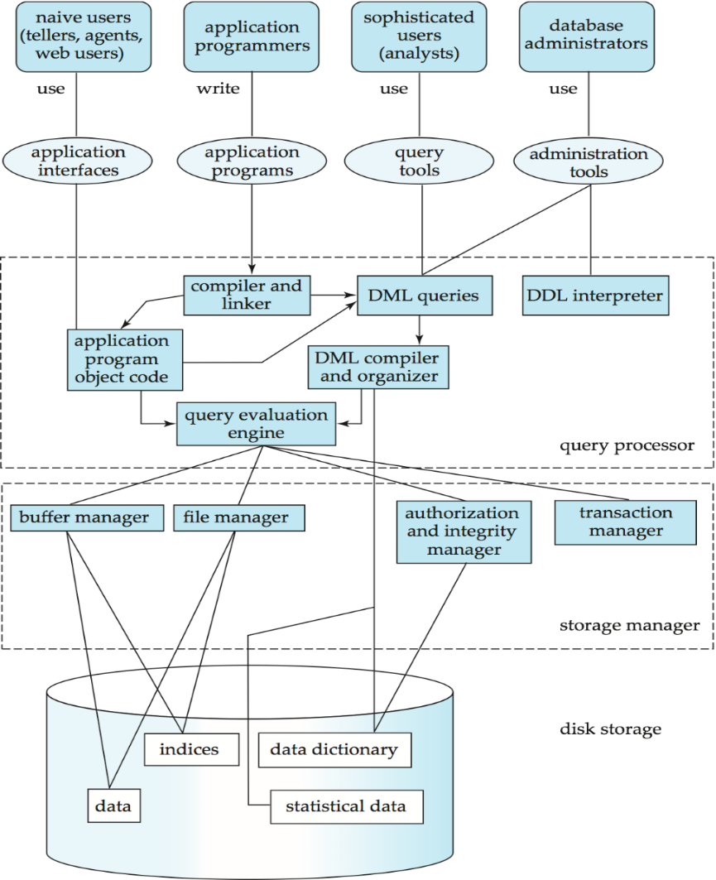
Users
Applications/tools
Database
System
Structure
DBMS
Database

Slide 4
Outline
☞ Overview
Measures of Query Cost
Selection Operation
Sorting
Join Operation
Other Operations
Evaluation of Expressions

Slide 5
Basic Steps in Query Processing
1. Parsing and translation
2. Optimization
3. Evaluation

Slide 6
Basic Steps in Query Processing
Parsing and translation
translate the query into the internal form which is then translated into relational algebra
Optimization
Generate the optimal execution plan (执行计划)
Execution
The query execution engine executes the evaluation plan, and returns the answers to the query

Slide 7
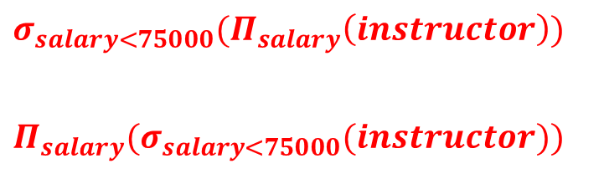
Query Optimization
select salary
from instructor
where salary < 75000
给出对应的关系代数表达式
$$σ_{salary<75000}(Π_{salary}\left(instructor\right))$$
$$Π_{salary}(σ_{salary<75000}(instructor))$$

Slide 8
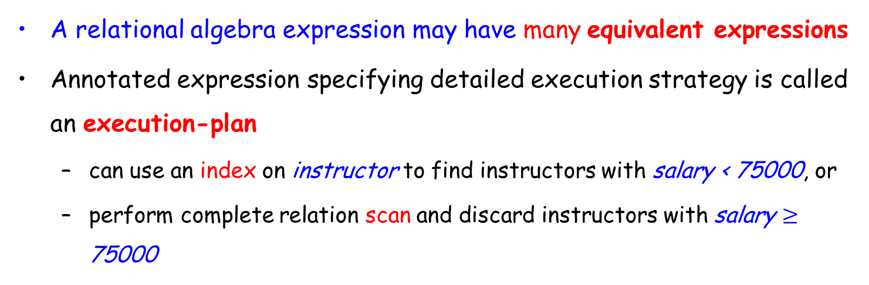
Query Optimization
A relational algebra expression may have many equivalent expressions
Annotated expression specifying detailed execution strategy is called an execution-plan
can use an index on instructor to find instructors with salary < 75000, or
perform complete relation scan and discard instructors with salary $≥$ 75000

Slide 9
Query Optimization (Cont.)
Query Optimization
Amongst all equivalent evaluation plans, choose the one with lowest cost
Cost is estimated using statistical information from the database catalog
This lecture
How to measure query costs
Algorithms for evaluating relational algebra operations
Combine algorithms for individual operations to evaluate a complete expression
Next lecture
The way to find an execution plan with the lowest estimated cost

Slide 10
Outline
Overview
☞ Measures of Query Cost
Selection Operation
Sorting
Join Operation
Other Operations
Evaluation of Expressions

Slide 11
Measures of Query Cost
Cost is generally measured as total elapsed time for answering query
disk accesses, CPU, and even network communication
Typically disk access is the predominant cost, and is also relatively easy to be estimated
Disk access is measured by taking into account
Number of seeks
Number of blocks read
Number of blocks written
The cost to write a block is greater than the cost to read a block
Data is read back after being written to ensure that the write was successful

Slide 12
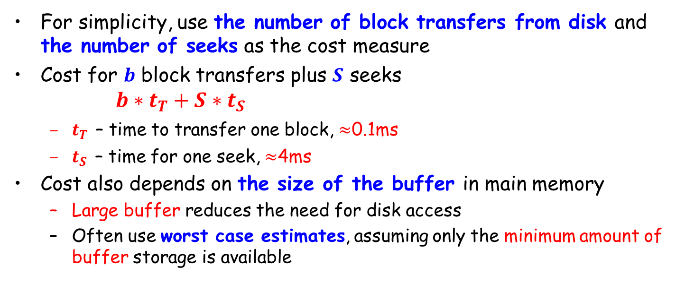
Measures of Query Cost (Cont.)
For simplicity, use the number of block transfers from disk and the number of seeks as the cost measure
Cost for $b$ block transfers plus $S$ seeks $b∗t_{T}+S∗t_{S}$
$t_{T}$ – time to transfer one block, $≈$0.1ms
$t_{S}$ – time for one seek, $≈$4ms
Cost also depends on the size of the buffer in main memory
Large buffer reduces the need for disk access
Often use worst case estimates, assuming only the minimum amount of buffer storage is available

Slide 13
Outline
Overview
Measures of Query Cost
☞ Selection Operation
Sorting
Join Operation
Other Operations
Evaluation of Expressions

Slide 14
Selection Operation
File scan (文件扫描)
Search algorithms that locate and retrieve records that satisfy a selection condition
Index scan (索引扫描)
Search algorithms that use an index
Selection condition must be on search-key of an index
Notes:
availability of indices：索引的可用性，即搜索的关键词是否被索引过

Slide 15
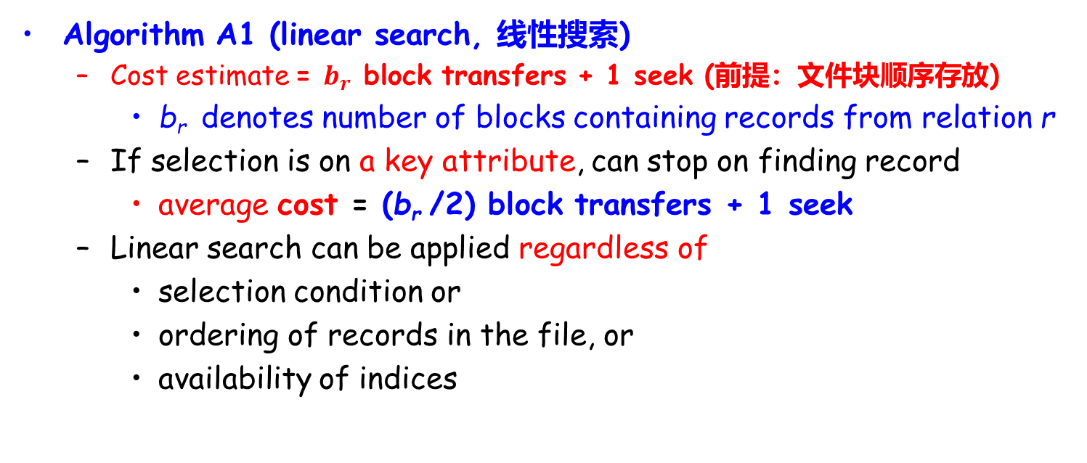
Selection Operation
Algorithm A1 (linear search, 线性搜索)
Cost estimate = $b_{r}$ block transfers + 1 seek (前提：文件块顺序存放)
b_{r} denotes number of blocks containing records from relation r
If selection is on a key attribute, can stop on finding record
average cost = (b_{r} /2) block transfers + 1 seek
Linear search can be applied regardless of
selection condition or
ordering of records in the file, or
availability of indices
Notes:
availability of indices：索引的可用性，即搜索的关键词是否被索引过

Slide 16
Selection Operation (Cont.)
A1’ (binary search).
Applicable if selection is an equality comparison on the attribute on which file is ordered.
Assume that the blocks of a relation are stored contiguously
Cost estimate (number of disk blocks to be scanned):
cost of locating the first tuple by a binary search on the blocks
worst cost ⎡log₂(b_{r})⎤ * (t_{T} + t_{S})
If there are multiple records satisfying selection
Add transfer cost of the number of blocks containing records that satisfy selection condition

Slide 17
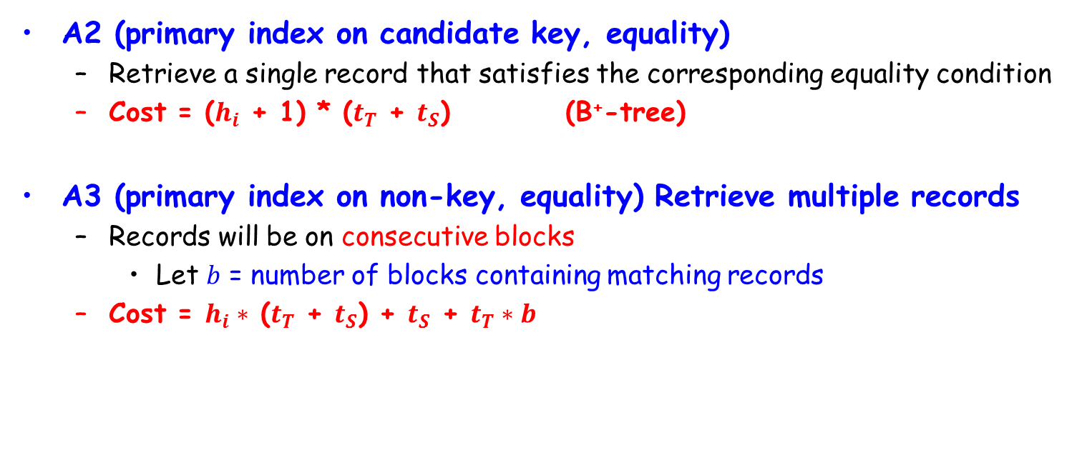
Selections Using Indices
A2 (primary index on candidate key, equality)
Retrieve a single record that satisfies the corresponding equality condition
Cost = ($h_{i}$ + 1) * ($t_{T}$ + $t_{S}$) (B⁺-tree)
A3 (primary index on non-key, equality) Retrieve multiple records
Records will be on consecutive blocks
Let $b$ = number of blocks containing matching records
Cost = $h_{i}∗$ ($t_{T}$ + $t_{S}$) + $t_{S}$ + $t_{T}∗b$

Slide 18
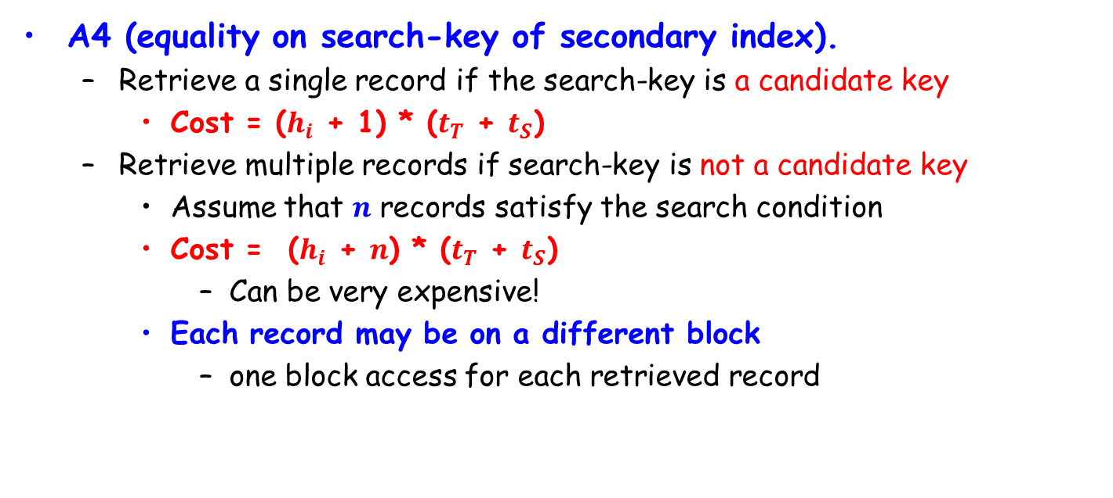
Selections Using Indices (Cont.)
A4 (equality on search-key of secondary index).
Retrieve a single record if the search-key is a candidate key
Cost = ($h_{i}$ + 1) * ($t_{T}$ + $t_{S}$)
Retrieve multiple records if search-key is not a candidate key
Assume that $n$ records satisfy the search condition
Cost = ($h_{i}$ + $n$) * ($t_{T}$ + $t_{S}$)
Can be very expensive!
Each record may be on a different block
one block access for each retrieved record

Slide 19
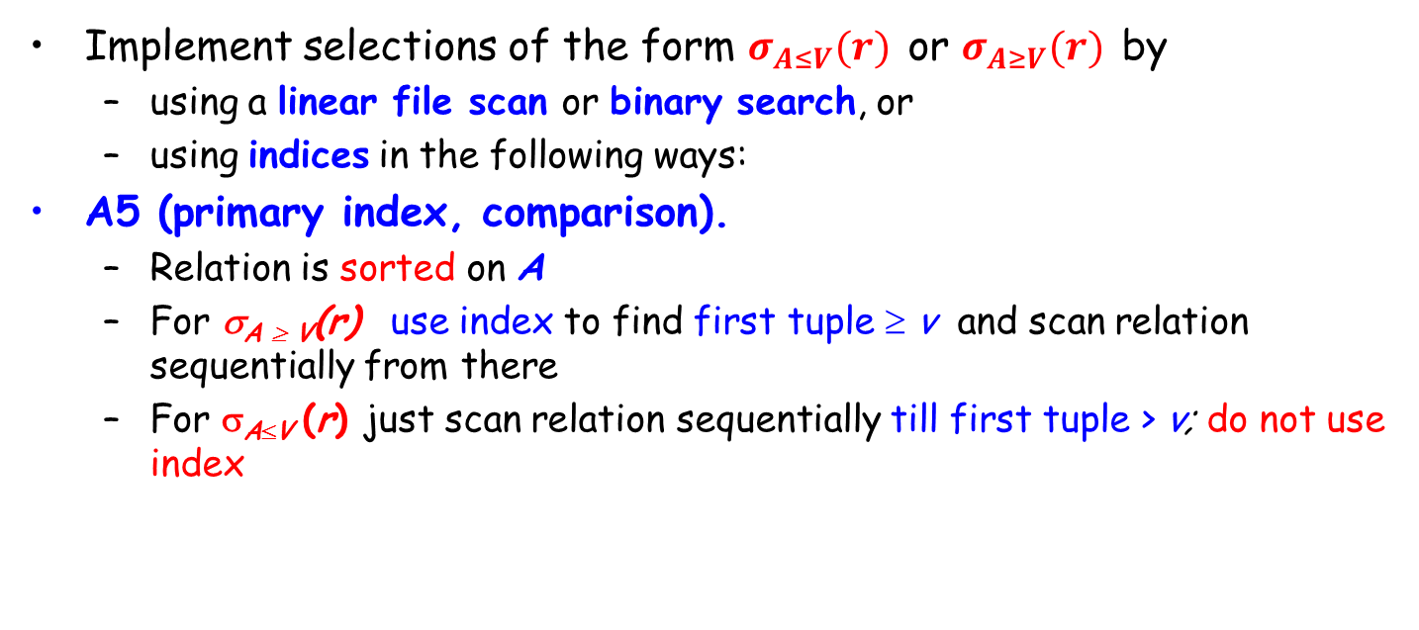
Selections Involving Comparisons
Implement selections of the form $σ_{A≤V}(r)$ or $σ_{A≥V}(r)$ by
using a linear file scan or binary search, or
using indices in the following ways:
A5 (primary index, comparison).
Relation is sorted on A
For σ_{A ≥ V}(r) use index to find first tuple ≥ v and scan relation sequentially from there
For σ_{A≤V} (r) just scan relation sequentially till first tuple > v; do not use index

Slide 20
Selections Involving Comparisons (Cont.)
A6 (secondary index, comparison).
For σ_{A ≥ V} (r) use index to find first index entry ≥ v and scan index sequentially from there, to find pointers to records.
For σ_{A≤V} (r) just scan leaf pages of index finding pointers to records, till first entry > v
In either case, retrieve records that are pointed to
requires an I/O for each record
Linear file scan may be cheaper if many records are to be fetched!

Slide 21
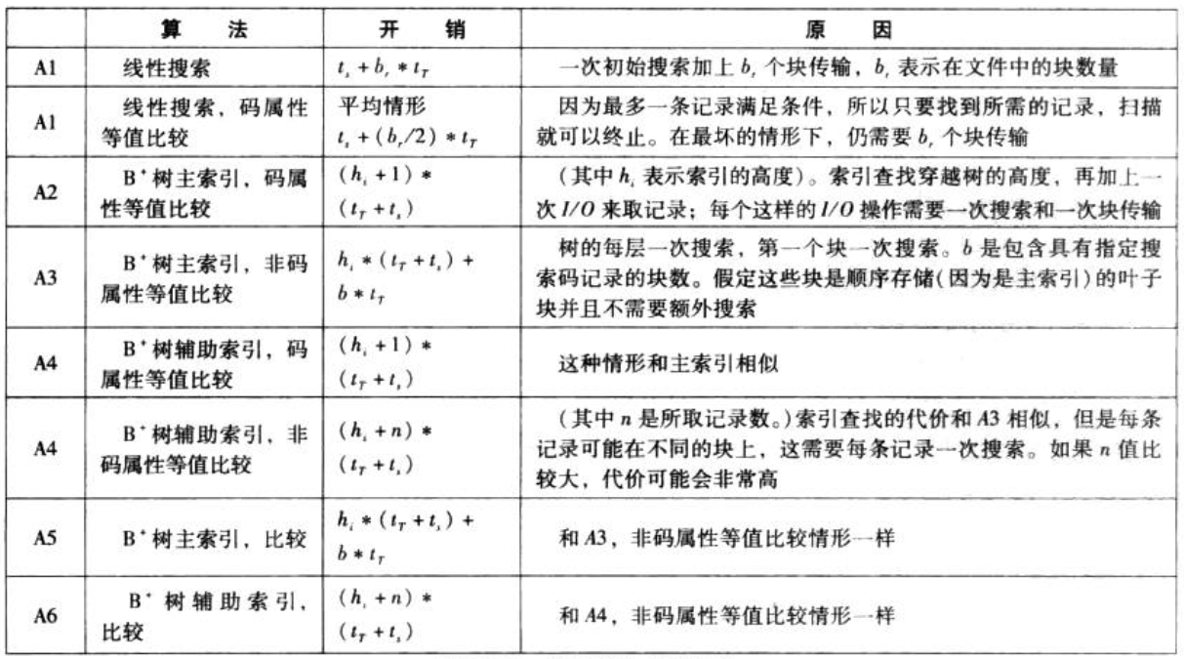

Selection Operation Cost Estimation
$h_{i}∗$ ($t_{T}$ + $t_{S}$) +
$t_{S}$ + $t_{T}∗b$

Slide 22
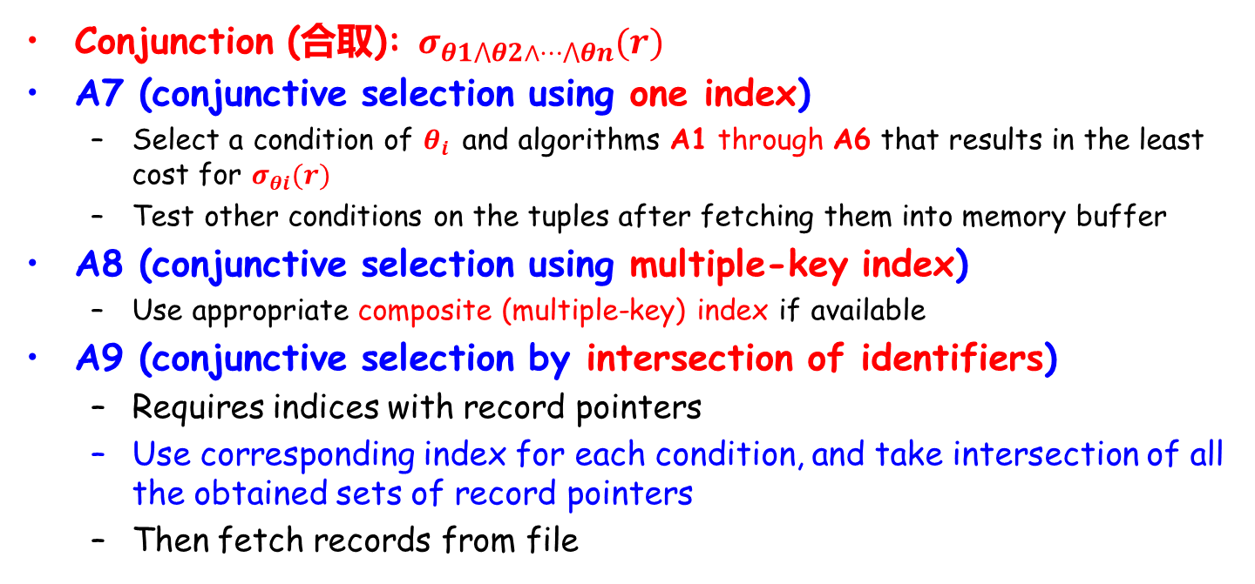
Implementation of Complex Selections
Conjunction (合取): $σ_{θ1⋀θ2∧⋯⋀θn}(r)$
A7 (conjunctive selection using one index)
Select a condition of $θ_{i}$ and algorithms A1 through A6 that results in the least cost for $σ_{θi}(r)$
Test other conditions on the tuples after fetching them into memory buffer
A8 (conjunctive selection using multiple-key index)
Use appropriate composite (multiple-key) index if available
A9 (conjunctive selection by intersection of identifiers)
Requires indices with record pointers
Use corresponding index for each condition, and take intersection of all the obtained sets of record pointers
Then fetch records from file

Slide 23
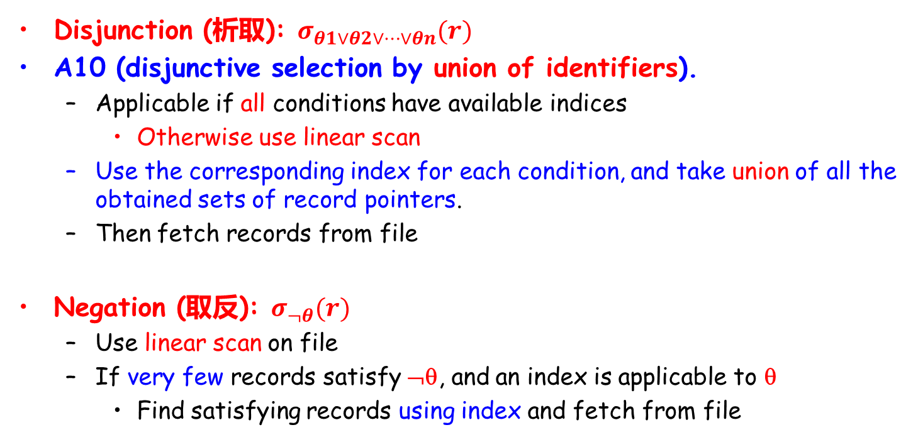
Implementation of Complex Selections (Cont.)
Disjunction (析取): $σ_{θ1∨θ2∨⋯∨θn}(r)$
A10 (disjunctive selection by union of identifiers).
Applicable if all conditions have available indices
Otherwise use linear scan
Use the corresponding index for each condition, and take union of all the obtained sets of record pointers.
Then fetch records from file
Negation (取反): $σ_{¬θ}(r)$
Use linear scan on file
If very few records satisfy ¬θ, and an index is applicable to θ
Find satisfying records using index and fetch from file

Slide 24
Outline
Overview
Measures of Query Cost
Selection Operation
☞ Sorting
Join Operation
Other Operations
Evaluation of Expressions

Slide 25
Sorting
We can build an index on the relation, and then use the index to read the relation in sorted order.
May lead to one disk block access for each tuple (for non-primary indices)
Relations that fit in memory
Techniques like quick-sort (快速排序) can be used
Relations that don’t fit in memory
External sort-merge (外部排序归并) is a good choice

Slide 26
排序的稳定性和复杂度
插入排序、选择排序、冒泡排序、快速排序、堆排序、归并排序、希尔排序、二叉树排序、计数排序、桶排序、基数排序…
不稳定：
选择排序（selection sort）: O(n²)
快速排序（quicksort）: O(nlogn) 平均时间, O(n²) 最坏情况; 对于大的、乱序串列一般认为是最快的已知排序
堆排序 （heapsort）: O(nlogn)
希尔排序 （shell sort）: O(nlogn)
基数排序（radix sort）: O(n·k); 需要 O(n) 额外存储空间 （K为特征个数）

Slide 27
排序的稳定性和复杂度
插入排序、选择排序、冒泡排序、快速排序、堆排序、归并排序、希尔排序、二叉树排序、计数排序、桶排序、基数排序…
稳定：
插入排序（insertion sort）: O(n²)
冒泡排序（bubble sort）: O(n²)
归并排序 （merge sort）: O(n log n); 需要 O(n) 额外存储空间
二叉树排序（Binary tree sort）: O(nlogn); 需要 O(n) 额外存储空间
计数排序 (counting sort) : O(n+k); 需要 O(n+k) 额外存储空间，k为序列中Max-Min+1
桶排序 （bucket sort）: O(n); 需要 O(k) 额外存储空间

Slide 28
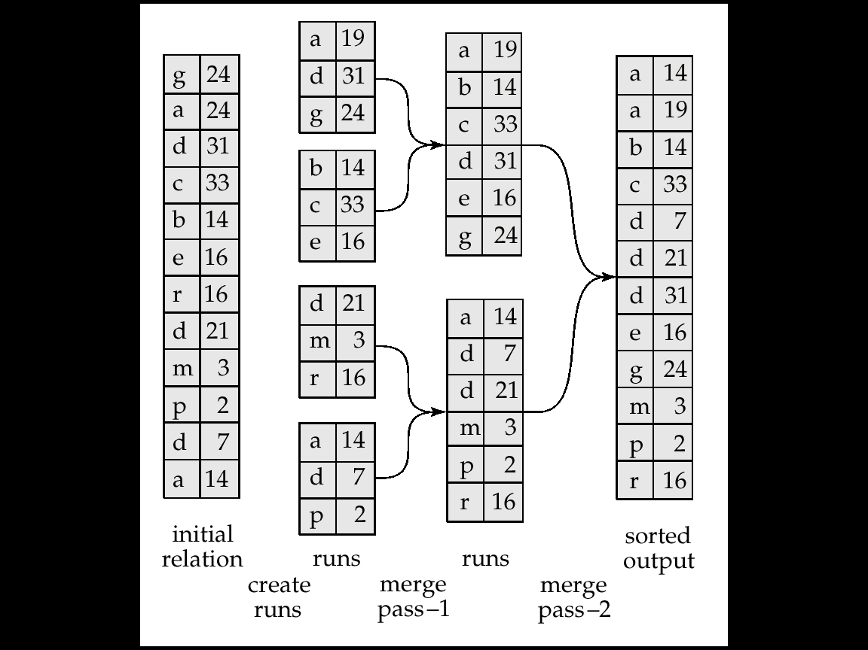
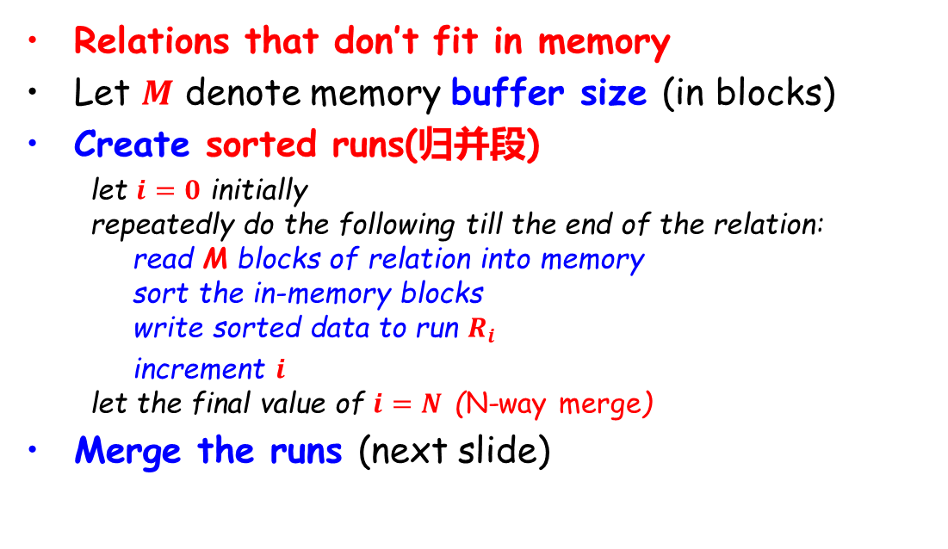
External Sort-Merge (外部排序归并)
Relations that don’t fit in memory
Let $M$ denote memory buffer size (in blocks)
Create sorted runs(归并段)
let $i=0$ initially repeatedly do the following till the end of the relation: read M blocks of relation into memory sort the in-memory blocks write sorted data to run $R_{i}$
increment $i$ let the final value of $i=N$ (N-way merge)
Merge the runs (next slide)
Assume:
Only one tuple fits in a block
Memory holds at most 3 blocks, 2 for input and 1 for output

Slide 29
External Sort-Merge (cont.)
Merge the runs (N-way merge, N路归并). We assume N < M
Use N blocks of memory to buffer input runs, and 1 block to buffer output. Read the first block of each run into its buffer page
repeat
select the first record (in sort order) among all buffer blocks
write the record to the output buffer block. If the output buffer is full, write it to disk
delete the record from the input buffer block If the buffer block becomes empty then read the next block of the run into the buffer
until all input buffer blocks are empty

Slide 30
External Sort-Merge (Cont.)
If N ≥ M, several merge passes (多趟归并) are required
In each pass, contiguous groups of M - 1 runs are merged.
A pass reduces the number of runs by a factor of M -1.
E.g. If M=11, and there are 90 runs, one pass reduces the number of runs to 9, each 10 times the size of the initial runs
Repeated passes are performed till all runs have been merged into one

Slide 31
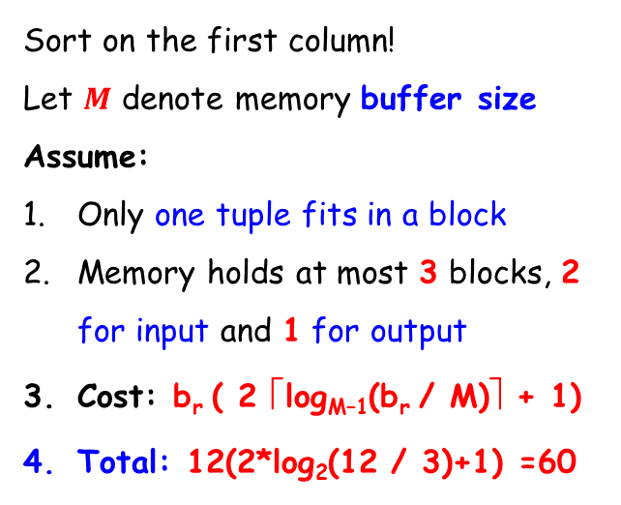
Example: External Sorting using Sort-Merge
Sort on the first column!
Let $M$ denote memory buffer size
Assume:
Only one tuple fits in a block
Memory holds at most 3 blocks, 2 for input and 1 for output
Cost: b_{r} ( 2 ⎡log_{M–1}(b_{r} / M)⎤ + 1)
Total: 12(2*log₂(12 / 3)+1) =60

Slide 32
External Merge Sort (Cont.)
Cost analysis:
Let b_{r} denote the number of blocks containing records of relation r
The intial number of runs is ⎡ b_{r}/M ⎤
Total number of merge passes required: ⎡log_{M–1}(b_{r}/M)⎤.
Disk accesses for initial run creation as well as in each pass is 2b_{r} (read in + write out)
for final pass, we don’t count write cost. We ignore final write cost for all operations since the output of an operation may be sent to the parent operation without being written to disk.
Each pass (except the final pass) reads every block once and writes out once. Thus total number of disk accesses for external sorting:
b_{r} ( 2 ⎡log_{M–1}(b_{r} / M)⎤ + 1):
Example: 12(2*log₂(12 / 3)+1) =60

Slide 33
External Merge Sort (Cont.)
Cost of seeks
During run generation: one seek to read each run and one seek to write each run
2 ⎡b_{r} / M⎤
During the merge phase
Buffer size: b_{b} (read/write b_{b} blocks at a time)
Need 2 ⎡b_{r} / b_{b}⎤ seeks for each merge pass
except the final one which does not require a write
Total number of seeks: 2 ⎡b_{r} / M⎤ + ⎡b_{r} / b_{b}⎤ (2 ⎡log_{M–1}(b_{r} / M)⎤ -1)
Applying the equation to the example, we get:
2*(12/3)+(12/1)(2* log₂ (12 / 3)-1) =8+12*3 = 44 seeks

Slide 34
Outline
Overview
Measures of Query Cost
Selection Operation
Sorting
☞ Join Operation
Other Operations
Evaluation of Expressions

Slide 35
Join Operation
Algorithms to implement joins
Nested-loop join (嵌套循环连接)
Block nested-loop join (块嵌套循环连接)
Indexed nested-loop join (索引嵌套循环连接)
Merge-join (归并连接)
Hash-join (散列连接)
Examples use the following information
#records
customer: 10000
depositor: 5000
#blocks
customer: 400
depositor: 100

Slide 36
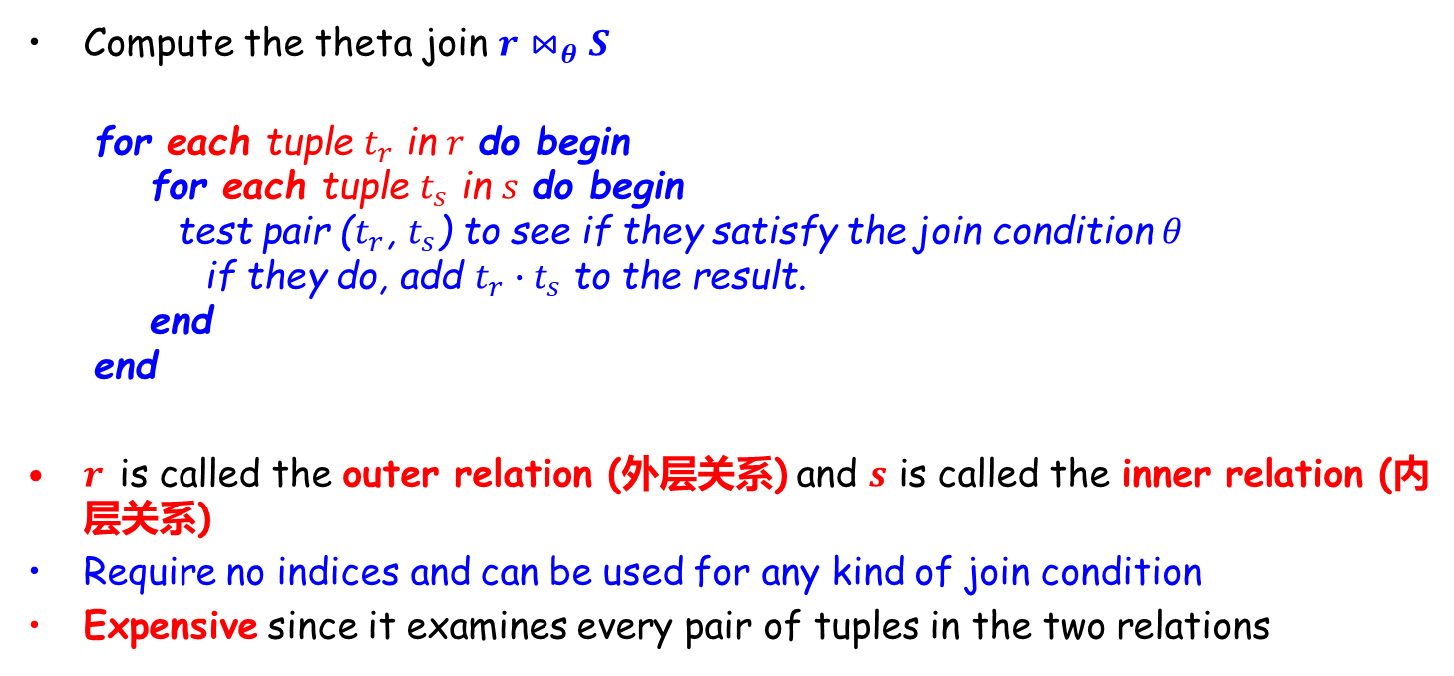
Nested-Loop Join (嵌套循环连接)
Compute the theta join $r⋈_{θ}S$
for each tuple $t_{r}$ in $r$ do begin for each tuple $t_{s}$ in $s$ do begin test pair ($t_{r}$, $t_{s}$) to see if they satisfy the join condition $θ$ if they do, add $t_{r}∙t_{s}$ to the result. end end
$r$ is called the outer relation (外层关系) and $s$ is called the inner relation (内层关系)
Require no indices and can be used for any kind of join condition
Expensive since it examines every pair of tuples in the two relations

Slide 37
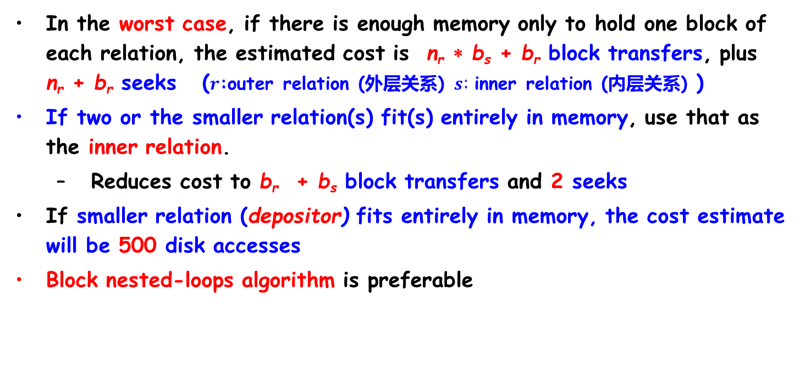
Nested-Loop Join (Cont.)
In the worst case, if there is enough memory only to hold one block of each relation, the estimated cost is n_{r} ∗ b_{s} + b_{r} block transfers, plus n_{r} + b_{r} seeks ($r$:outer relation (外层关系) $s$: inner relation (内层关系) )
If two or the smaller relation(s) fit(s) entirely in memory, use that as the inner relation.
Reduces cost to b_{r} + b_{s} block transfers and 2 seeks
If smaller relation (depositor) fits entirely in memory, the cost estimate will be 500 disk accesses
Block nested-loops algorithm is preferable
#records
customer: 10000
depositor: 5000
#blocks
customer: 400
depositor: 100

Slide 38
Nested-Loop Join (Cont.)
Given the worst case memory availability, the cost estimate is
n_{r} ∗ b_{s} + b_{r} block transfers plus n_{r} + b_{r} seeks
5000 * 400 + 100 = 2,000,100 disk accesses with depositor as outer relation, and 5000 + 100 = 5100 seeks
10000 * 100 + 400 = 1,000,400 disk accesses with customer as the outer relation, and 10,400 seeks
较小的关系做内层更优
If smaller relation (depositor) fits entirely in memory, the cost estimate will be 500 disk accesses，这时较小的关系做内层更优
#records
customer: 10000
depositor: 5000
#blocks
customer: 400
depositor: 100

Slide 39
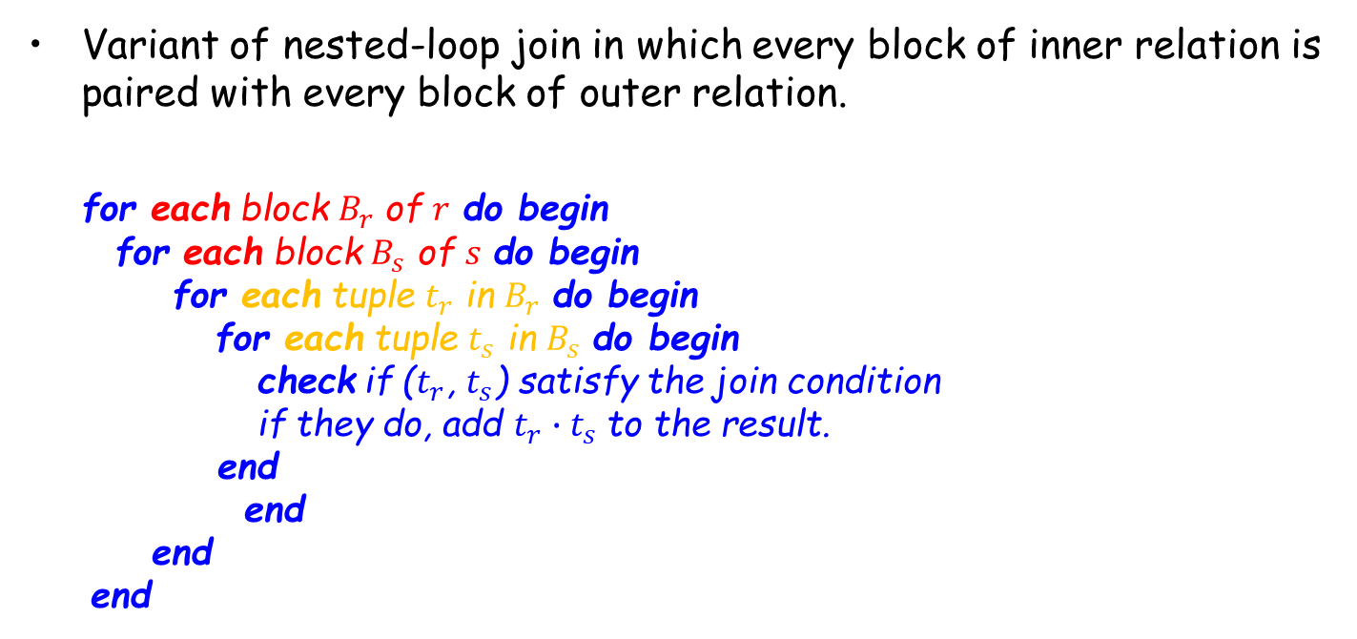
Block Nested-Loop Join (块嵌套循环连接)
Variant of nested-loop join in which every block of inner relation is paired with every block of outer relation.
for each block $B_{r}$ of $r$ do begin for each block $B_{s}$ of $s$ do begin for each tuple $t_{r}$ in $B_{r}$ do begin for each tuple $t_{s}$ in $B_{s}$ do begin check if ($t_{r}$, $t_{s}$) satisfy the join condition if they do, add $t_{r}∙t_{s}$to the result. end end end end

Slide 40
Block Nested-Loop Join (Cont.)
Worst case estimate: b_{r} ∗ b_{s} + b_{r} block transfers + 2 * b_{r} seeks
Each block in the inner relation s is read once for each block in the outer relation (instead of once for each tuple in the outer relation)
注：如内存不能容纳任何一个关系，则用较小的关系作为外层关系更有效
Eg. Cost of block nested loops join
100*400 +100 = 40,100 block transfers + 2 * 100 =200 seeks
Best case(内存能容纳内层关系，较小的关系做内层): b_{r} + b_{s} block transfers + 2 seeks
#records
customer: 10000
depositor: 5000
#blocks
customer: 400
depositor: 100

Slide 41
Block Nested-Loop Join (Cont.)
Improvements to nested loop and block nested loop algorithms:
In block nested-loop, use (M – 2) disk blocks as blocking unit for outer relations, where M = memory size in blocks; use remaining two blocks to buffer inner relation and output
Cost = ⎡b_{r} / (M-2)⎤ ∗ b_{s} + b_{r} block transfers + 2 ⎡b_{r} / (M-2)⎤ seeks
If equi-join attribute forms a key of inner relation, stop inner loop on first match
Scan inner relation forward and backward alternately, to make use of the blocks remaining in buffer (with LRU replacement)
Use index on inner relation if available (next slide)

Slide 42
Indexed Nested-Loop Join (索引嵌套循环连接)
Index lookups can replace file scans if
join is an equi-join or natural join and
an index is available on the inner relation’s join attribute
Can construct an index just to compute a join.
For each tuple t_{r} in the outer relation r, use the index to look up tuples in s that satisfy the join condition with tuple t_{r}.
Worst case: buffer has space for only one page of r, and, for each tuple in r, we perform an index lookup on s.
Cost of the join : b_{r} (t_{T} + t_{S}) + n_{r} ∗ c
Where c is the cost of traversing index and fetching all matching s tuples for one tuple of r
c can be estimated as cost of a single selection on s using the join condition.
If indices are available on join attributes of both r and s, use the relation with fewer tuples as the outer relation.

Slide 43
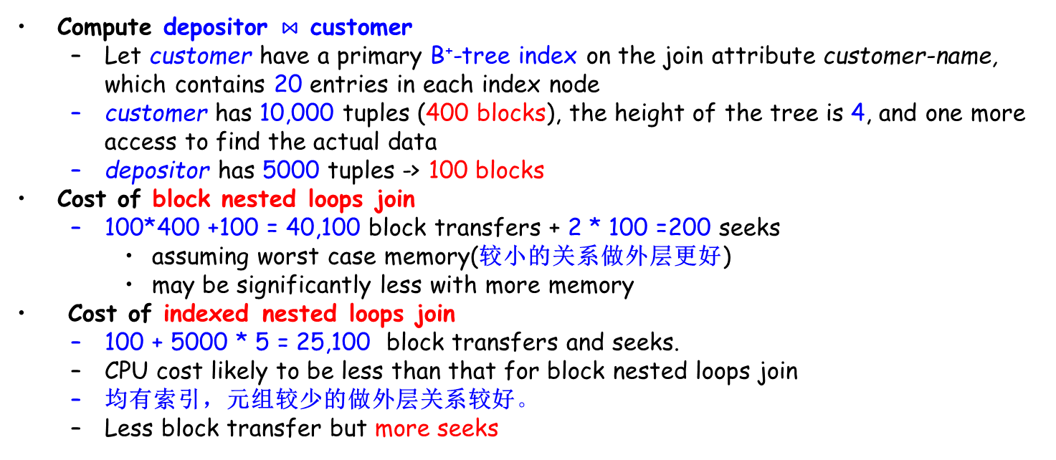
Example of Indexed Nested-Loop Join Costs
Compute depositor $⋈$ customer
Let customer have a primary B⁺-tree index on the join attribute customer-name, which contains 20 entries in each index node
customer has 10,000 tuples (400 blocks), the height of the tree is 4, and one more access to find the actual data
depositor has 5000 tuples -> 100 blocks
Cost of block nested loops join
100*400 +100 = 40,100 block transfers + 2 * 100 =200 seeks
assuming worst case memory(较小的关系做外层更好)
may be significantly less with more memory
Cost of indexed nested loops join
100 + 5000 * 5 = 25,100 block transfers and seeks.
CPU cost likely to be less than that for block nested loops join
均有索引，元组较少的做外层关系较好。
Less block transfer but more seeks
#records
customer: 10000
depositor: 5000
#blocks
customer: 400
depositor: 100

Slide 44
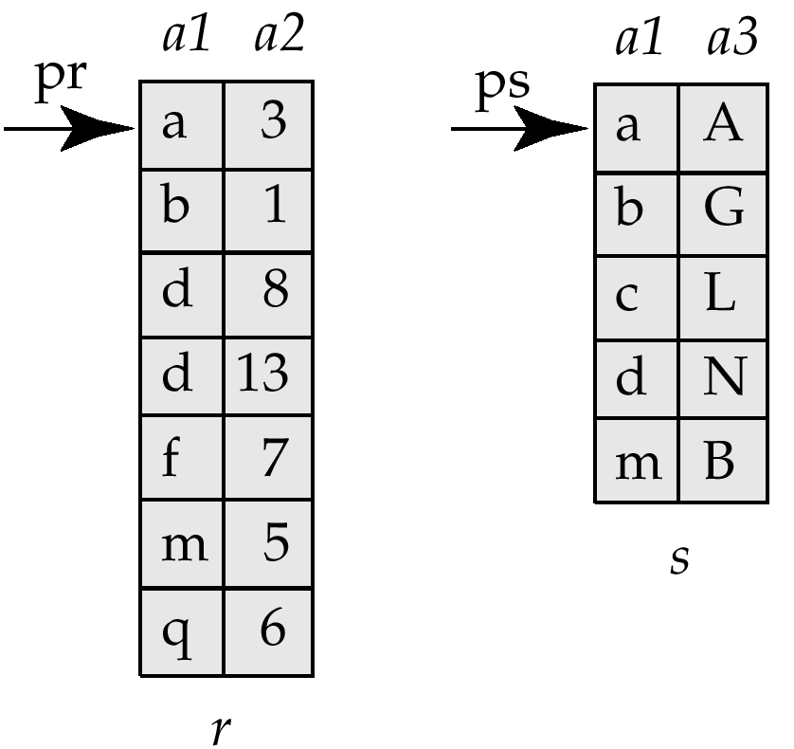
Merge-Join* (归并连接)
Sort both relations on their join attribute (if not already sorted on the join attributes)
Merge the sorted relations to join them
Join step is similar to the merge stage of the sort-merge algorithm
Main difference is handling of duplicate values in join attribute - every pair with same value on join attribute must be matched

Slide 45
Merge-Join (Cont.)
Can be used only for equi-joins and natural joins
Each block needs to be read only once (assuming all tuples for any given value of the join attributes fit in memory)
Thus number of block accesses for merge-join is b_{r} + b_{s} + the cost of sorting if relations are unsorted.
Hybrid merge-join (combining indices with merge-join): If one relation is sorted, and the other has a secondary B⁺-tree index on the join attribute
Merge the sorted relation with the leaf entries of the B⁺-tree, the result file contains tuples from the sorted file and the addresses from the unsorted file
Sort the result file on the addresses of the unsorted relation’s tuples
Scan the unsorted relation in physical address order and merge with previous result, to replace addresses by the actual tuples

Slide 46
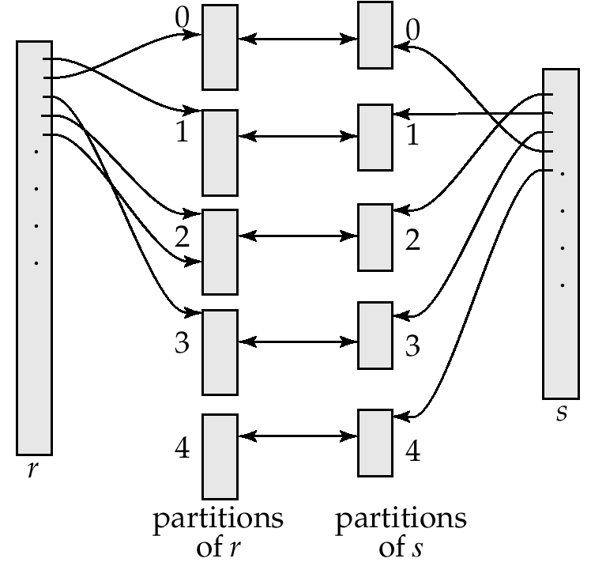
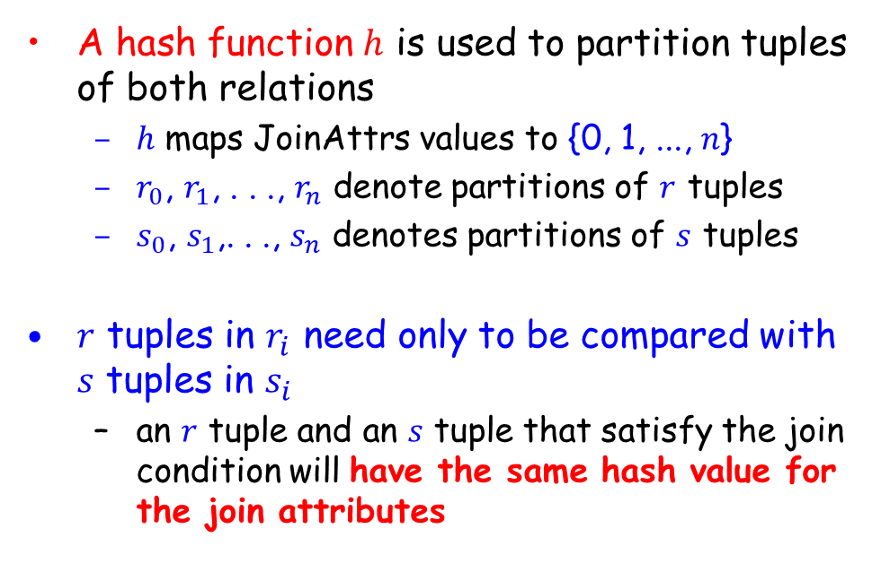
Hash-Join* (散列连接)
A hash function $h$ is used to partition tuples of both relations
$h$ maps JoinAttrs values to {0, 1, ..., $n$}
$r_{0}$, $r_{1}$, . . ., $r_{n}$ denote partitions of $r$ tuples
$s_{0}$, $s_{1}$,. . ., $s_{n}$ denotes partitions of $s$ tuples
$r$ tuples in $r_{i}$ need only to be compared with $s$ tuples in $s_{i}$
an $r$ tuple and an $s$ tuple that satisfy the join condition will have the same hash value for the join attributes

Slide 47

Hash-Join Algorithm
The hash-join of $r$ and $s$ is computed as follows
1. Partition the relation s using hashing function h. When partitioning a relation, one block of memory is reserved as the output buffer for each partition.
2. Partition r similarly.
3. For each i:
(a) Load s_{i} into memory and build an in-memory hash index on it using the join attribute. This hash index uses a different hash function than the earlier one h.
(b) Read the tuples in r_{i} from the disk one by one. For each tuple t_{r} locate each matching tuple t_{s} in s_{i} using the in-memory hash index. Output the concatenation of their attributes.
Relation $s$ is called the build input(构造用输入) and $r$ is called the probe input(探查用输入)

Slide 48
Hash-Join algorithm (Cont.)
The value n and the hash function h is chosen such that each s_{i} should fit in memory.
Typically n is chosen as ⎡b_{s}/M⎤ * f where f is a “fudge factor”(避让因子), typically around 1.2
The probe relation partitions r_{i} need not fit in memory
Recursive partitioning required if number of partitions n is greater than number of pages M of memory.
instead of partitioning n ways, use M – 1 partitions for s
Further partition the M – 1 partitions using a different hash function
Use same partitioning method on r

Slide 49
Handling of Overflows
Hash-table overflow occurs in partition s_{i} if s_{i} does not fit in memory. Reasons could be
Many tuples in s with same value for join attributes
Bad hash function
Overflow resolution(溢出分解) can be done in build phase
Partition s_{i} is further partitioned using different hash function.
Partition r_{i} must be similarly partitioned.
Overflow avoidance(溢出避免) performs partitioning carefully to avoid overflows during build phase
E.g. partition build relation into many partitions, then combine them
Both approaches fail with large numbers of duplicates(大量元组链接属性相同)
Fallback option: use block nested loops join on overflowed partitions

Slide 50
Cost of Hash-Join
If recursive partitioning is not required: cost of hash join is 2(b_{r} + b_{s}) +(b_{r} + b_{s}) + 4n
If recursive partitioning required, number of passes required for partitioning s is ⎡log_{M–1}(b_{s}) – 1⎤.
the number of passes for partitioning of r is also the same as for s.
Therefore it is best to choose the smaller relation as the build relation.
Total cost estimate is:
2(b_{r} + b_{s}) ⎡ log_{M–1}(b_{s}) – 1⎤ + b_{r} + b_{s}
If the entire build input can be kept in main memory, n can be set to 0 and the algorithm does not partition the relations into temporary files. Cost estimate goes down to b_{r} + b_{s}.

Slide 51

Example of Cost of Hash-Join
customer $⋈$ depositor
Assume that memory size is 20 blocks
b_{depositor}= 100 and b_{customer} = 400.
depositor is to be used as build input. Partition it into 5 partitions, each of size 20 blocks. This partitioning can be done in 1 pass.
Similarly, partition customer into 5 partitions, each of size 80. This is also done in 1 pass.
Therefore total cost: 3(100 + 400) = 1500 block transfers
ignores cost of writing partially filled blocks

Slide 52
Hybrid Hash–Join
Useful when memory sized are relatively large, and the build input is bigger than memory.
Main feature of hybrid hash join: Keep the first partition of the build relation in memory.
E.g. With memory size of 25 blocks, depositor can be partitioned into 5 partitions, each of size 20 blocks.
Division of memory:
The first partition occupies 20 blocks of memory（无需递归划分）
1 block is used for input, and 1 block each for buffering the other 4 partitions.

Slide 53
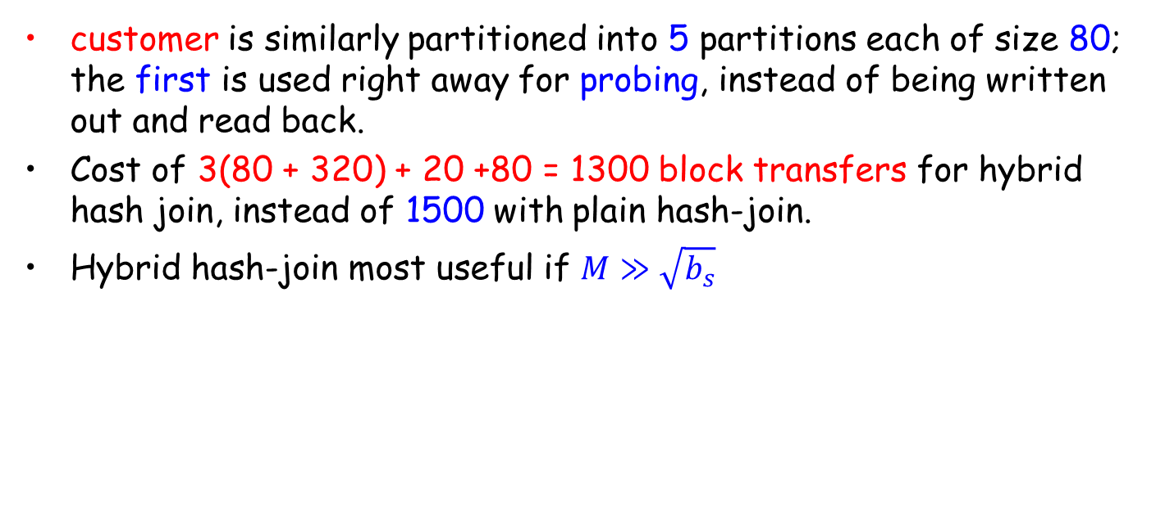
Hybrid Hash–Join
customer is similarly partitioned into 5 partitions each of size 80; the first is used right away for probing, instead of being written out and read back.
Cost of 3(80 + 320) + 20 +80 = 1300 block transfers for hybrid hash join, instead of 1500 with plain hash-join.
Hybrid hash-join most useful if $M≫\sqrt{b_{s}}$
Notes:
20 s_0+80 r_0没有写回和读入，因此比其它划分要少一次写一次读。参考12.5.5.4中第一个公式

Slide 54
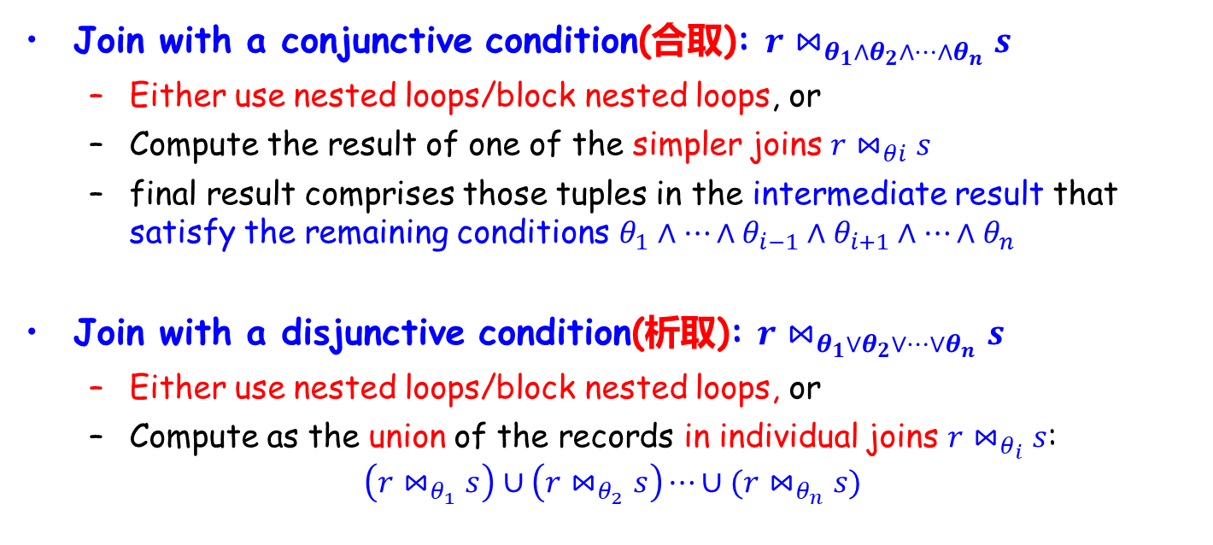
Complex Joins
Join with a conjunctive condition(合取): $r⋈_{θ_{1}∧θ_{2}∧…∧θ_{n}}s$
Either use nested loops/block nested loops, or
Compute the result of one of the simpler joins $r⋈_{θi}s$
final result comprises those tuples in the intermediate result that satisfy the remaining conditions $θ_{1}∧…∧θ_{i−1}∧$ $θ_{i+1}∧…∧θ_{n}$
Join with a disjunctive condition(析取): $r⋈_{θ_{1}∨θ_{2}∨…∨θ_{n}}s$
Either use nested loops/block nested loops, or
Compute as the union of the records in individual joins $r⋈_{θ_{i}}s$:
$$\left(r⋈_{θ_{1}}s\right)∪\left(r⋈_{θ_{2}}s\right)⋯∪(r⋈_{θ_{n}}s)$$

Slide 55
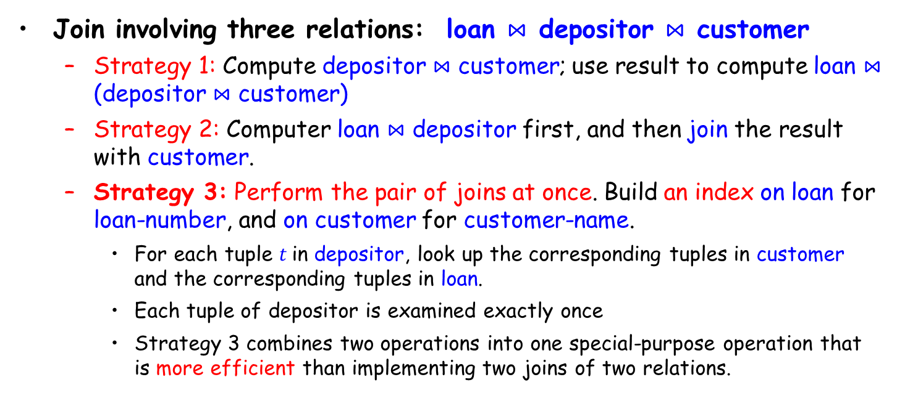
Complex Joins
Join involving three relations: loan $⋈$ depositor $⋈$ customer
Strategy 1: Compute depositor $⋈$ customer; use result to compute loan $⋈$ (depositor $⋈$ customer)
Strategy 2: Computer loan $⋈$ depositor first, and then join the result with customer.
Strategy 3: Perform the pair of joins at once. Build an index on loan for loan-number, and on customer for customer-name.
For each tuple $t$in depositor, look up the corresponding tuples in customer and the corresponding tuples in loan.
Each tuple of depositor is examined exactly once
Strategy 3 combines two operations into one special-purpose operation that is more efficient than implementing two joins of two relations.

Slide 56
Outline
Overview
Measures of Query Cost
Selection Operation
Sorting
Join Operation
☞ Other Operations
Evaluation of Expressions

Slide 57
Duplicate Elimination & Projection
Duplicate elimination can be implemented via hashing or sorting
On sorting duplicates will come adjacent to each other, and all but one copy of duplicates can be deleted.
Optimization: duplicates can be deleted during run generation as well as at intermediate merge steps in external sort-merge
Hashing is similar – duplicates will come into the same bucket
Projection is implemented by performing projection on each tuple followed by duplicate elimination

Slide 58
Aggregation
Aggregation can be implemented in a manner similar to duplicate elimination
Sorting or hashing can be used to bring tuples in the same group together, and then the aggregate functions can be applied on each group
Optimization: combine tuples in the same group during run generation and intermediate merges, by computing partial aggregate values
For count, min, max, sum: keep aggregate values on tuples found so far in the group.
For avg, keep sum and count, and divide sum by count at the end

Slide 59
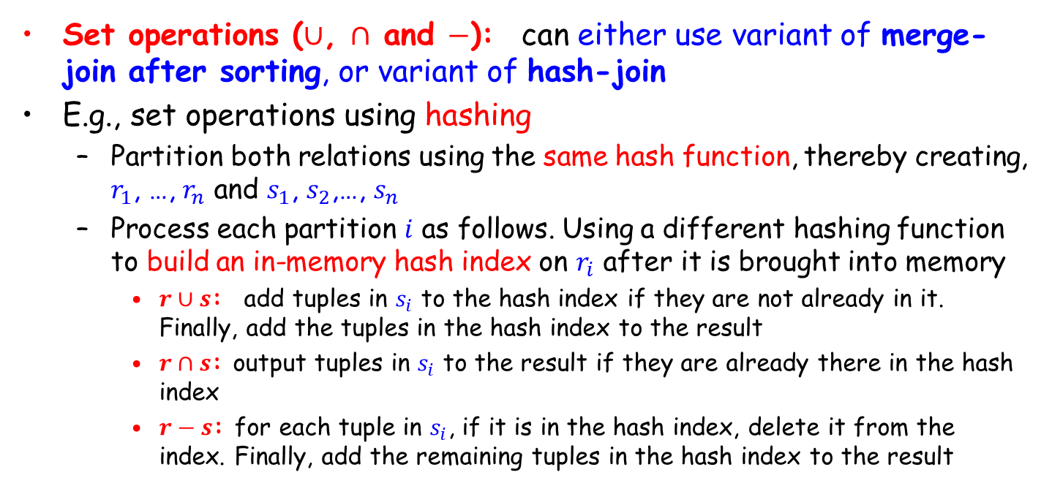
Set Operations
Set operations ($∪$, $∩$ and $−$): can either use variant of merge-join after sorting, or variant of hash-join
E.g., set operations using hashing
Partition both relations using the same hash function, thereby creating, $r_{1}$, …, $r_{n}$ and $s_{1}$, $s_{2}$,…, $s_{n}$
Process each partition $i$ as follows. Using a different hashing function to build an in-memory hash index on $r_{i}$ after it is brought into memory
$r∪s$: add tuples in $s_{i}$ to the hash index if they are not already in it. Finally, add the tuples in the hash index to the result
$r∩s$: output tuples in $s_{i}$ to the result if they are already there in the hash index
$r−s$: for each tuple in $s_{i}$, if it is in the hash index, delete it from the index. Finally, add the remaining tuples in the hash index to the result

Slide 60
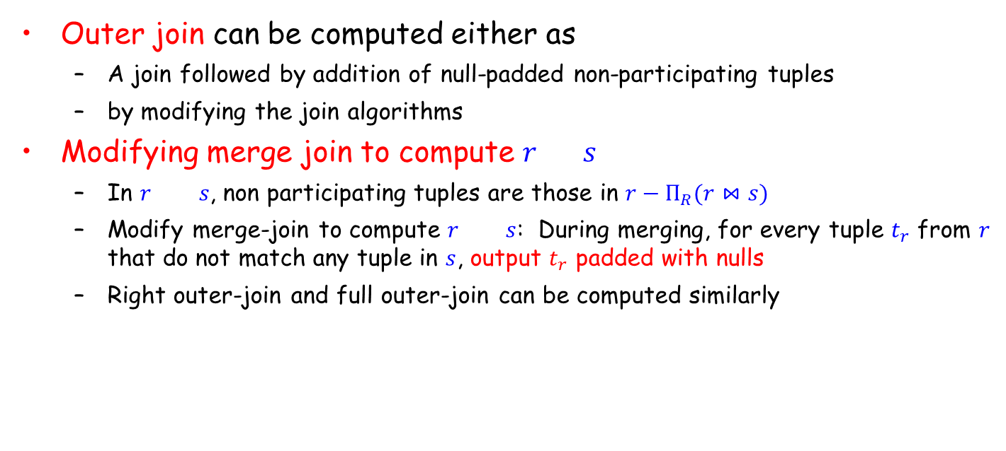
Outer Join
Outer join can be computed either as
A join followed by addition of null-padded non-participating tuples
by modifying the join algorithms
Modifying merge join to compute $r s$
In $r s$, non participating tuples are those in $r−Π_{R}(r⋈s)$
Modify merge-join to compute $r s$: During merging, for every tuple $t_{r}$ from $r$ that do not match any tuple in $s$, output $t_{r}$ padded with nulls
Right outer-join and full outer-join can be computed similarly

Slide 61
Outline
Overview
Measures of Query Cost
Selection Operation
Sorting
Join Operation
Other Operations
☞ Evaluation of Expressions

Slide 62
Evaluation of Expressions
We have seen algorithms for individual operations
Alternatives for evaluating an entire expression tree
Materialization (物化): generate the results of an expression whose inputs are relations or are already computed, materialize (store) it on disk
Pipelining (流水线): pass on tuples to parent operations even as an operation is being executed

Slide 63
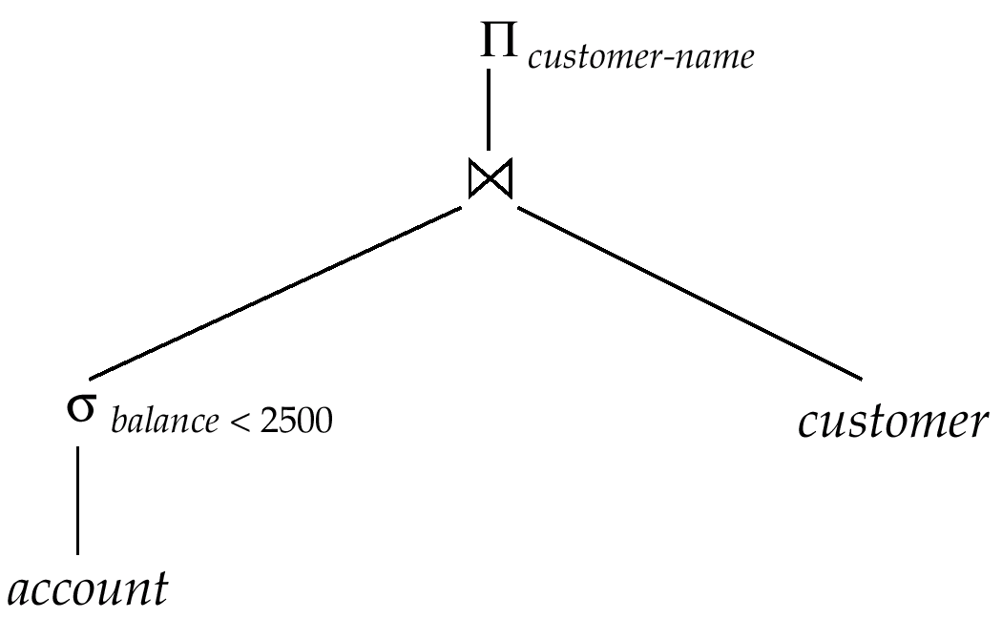
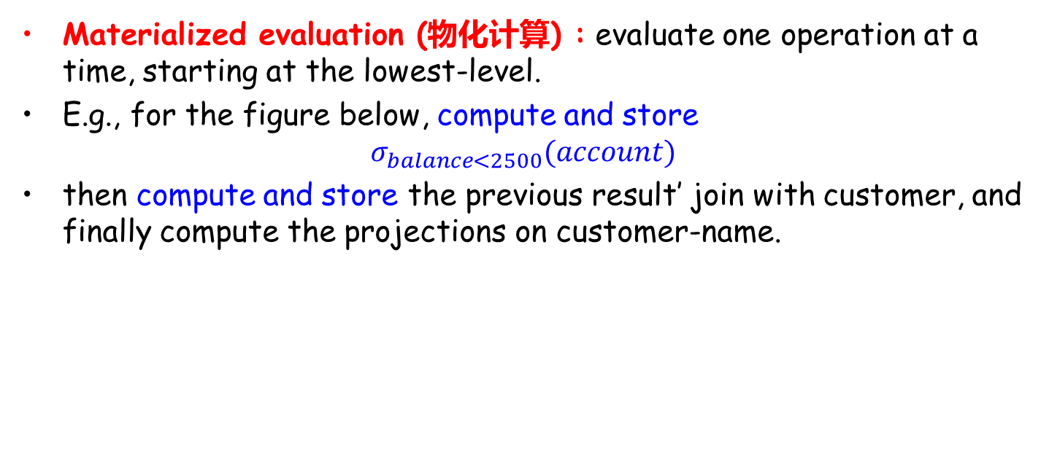
Materialization (物化)
Materialized evaluation (物化计算) : evaluate one operation at a time, starting at the lowest-level.
E.g., for the figure below, compute and store
$$σ_{balance<2500}(account)$$
then compute and store the previous result’ join with customer, and finally compute the projections on customer-name.
Notes:
Operator tree : 运算符树

Slide 64
Materialization (Cont.)
Materialized evaluation (物化计算) is always applicable
Cost of writing results to disk and reading them back can be quite high
overall cost = sum of costs of individual operations + cost of writing intermediate results to disk
Double buffering (双缓冲): use two output buffers for each operation, when one is full write it to disk while the other is getting filled
Reduce the execution time

Slide 65
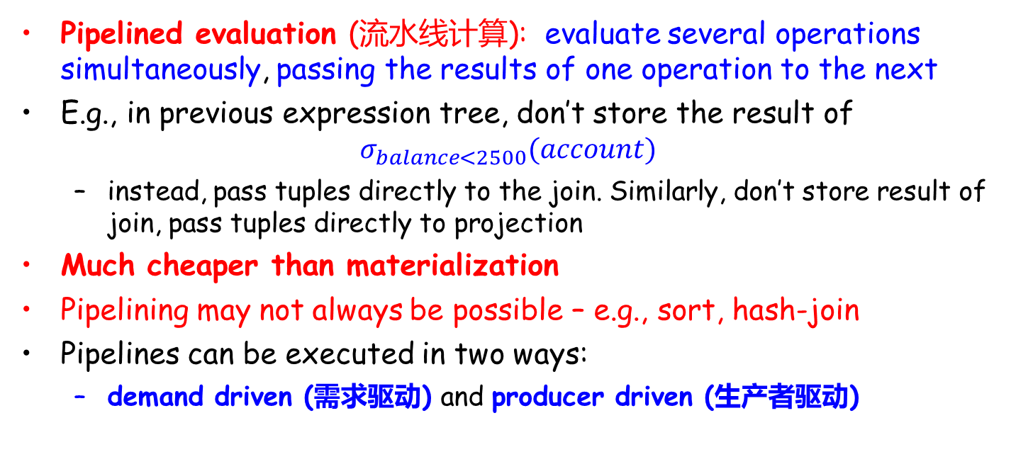
Pipelining (流水线)
Pipelined evaluation (流水线计算): evaluate several operations simultaneously, passing the results of one operation to the next
E.g., in previous expression tree, don’t store the result of
$$σ_{balance<2500}(account)$$
instead, pass tuples directly to the join. Similarly, don’t store result of join, pass tuples directly to projection
Much cheaper than materialization
Pipelining may not always be possible – e.g., sort, hash-join
Pipelines can be executed in two ways:
demand driven (需求驱动) and producer driven (生产者驱动)

Slide 66
Pipelining (Cont.)
demand driven or lazy evaluation
System repeatedly requests next tuple from top level operation
Each operation requests next tuple from children operations as required, in order to output its next tuple
Between calls, operation has to maintain “state” so it knows what to return next
Each operation is implemented as an iterator implementing the following operations
open()
E.g. file scan: initialize file scan, store pointer to beginning of file as state
E.g.merge join: sort relations and store pointers to beginning of sorted relations as state
next()
E.g. for file scan: Output next tuple, and advance and store file pointer
E.g. for merge join: continue with merge from earlier state till next output tuple is found. Save pointers as iterator state.
close()

Slide 67
Pipelining (Cont.)
producer-driven or eager pipelining
Operators produce tuples eagerly and pass them up to their parents
Buffer maintained between operators, child puts tuples in buffer, parent removes tuples from buffer
if buffer is full, child waits till there is space in the buffer, and then generates more tuples
System schedule operations that have space in output buffer and can process more input tuples

Slide 68
End of Lecture 15

